Slide 1
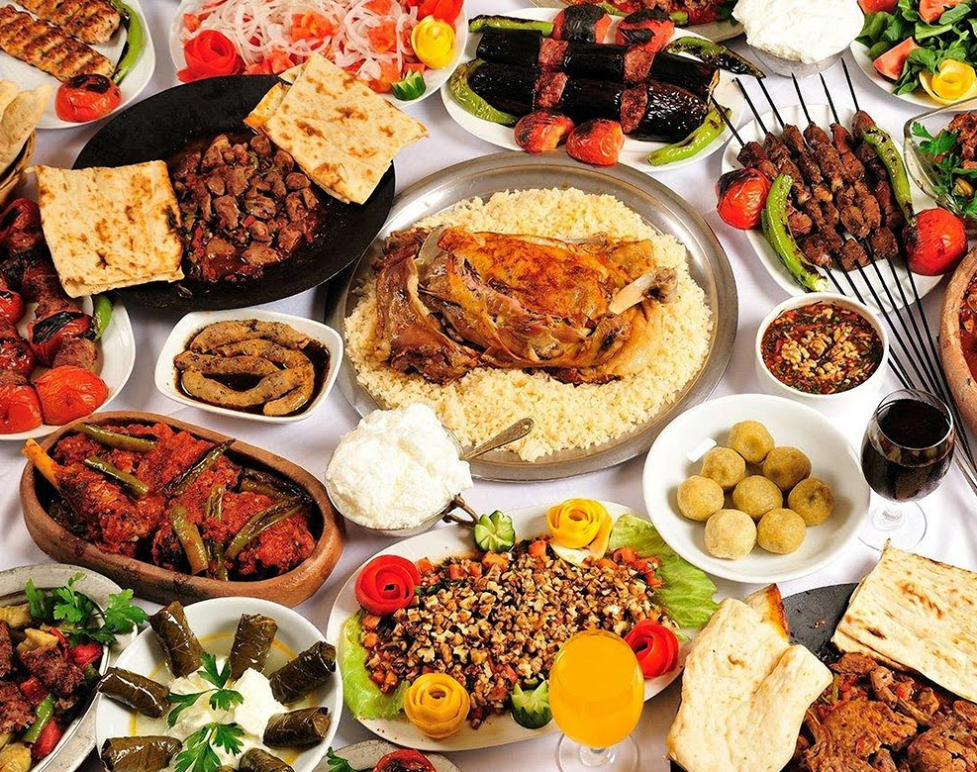
Food Traditions in Turkiye
ERASMUS+ PROJECT
FOOD FOR THOUGHT
By Mete Orkun Kafadar

Slide 2
Halva (Helva)
The Turkish tradition of halva is one of the oldest desserts prepared by cooking ingredients such as tahini, sugar and flour. It is a tradition to pray for the deceased person after the halva is eaten. In Turkish culture, making halva is an expression of love and respect. It has become a tradition to distribute halva among neighbors and relatives.

Slide 3
Turkish Coffee (Türk Kahvesi)
Turkish coffee is one of the most important drinks of Turkish cuisine. Turkish coffee is preferred black, medium and sweetened, and the foam formed on top is used for fortune telling. As a tradition, when you go to ask for the girl, coffee is served to the guests by the girl to be asked. She offers salty coffee to the man she will marry.

Slide 4
Ramadan Pita
Ramadan Pita is sold from the first day of Ramadan, especially in bakeries, and has a special place during Ramadan. People form long queues in front of bakeries every evening to buy pita bread. Ramadan Pita is a tradition that creates the spiritual atmosphere of Ramadan and is an indispensable part of many families' iftar table.

Slide 5
Lokma
Lokma is a sweet pastry made for the anniversaries of people who have passed away. The dough is cut into small balls, fried and served with syrup. Lokma dessert was made to help the poor and over time it has become a dessert for festivals and celebrations. The Turkish tradition of lokma reflects the culture of solidarity.

Slide 6
Keşkek
Keşkek is a dish consumed in Turkish food culture, especially in Central Anatolia and Eastern Anatolia. Made with corn, wheat and meat, there is a tradition of preparation by young girls at village weddings and it is usually eaten collectively.

Slide 7
Ashura (Aşure)
Ashura is a dessert cooked in Turkish cuisine on the tenth day of the month of Muharram. Ingredients such as wheat, chickpeas, dried beans, rice, dried apricots, raisins, walnuts, cinnamon and sugar are used and it is usually made in batches. It is a tradition that dates back to the Ottoman period and is considered a symbol of brotherhood and solidarity.

Slide 8
Turkish Delight (Lokum)
Turkish delight has a history dating back to the Ottoman Empire. It is prepared by cooking sugar, starch and water. Turkish delight, which always has a place at the table during holidays, family and friend visits, pleasant conversations, can be served to guests with coffee or alone for "sweetening the mouth" as a tradition. It is known as one of the indispensables of Turkish people.

Slide 9
Güllaç
Güllaç is a traditional dessert consumed in Turkish cuisine, especially during Ramadan. Rose pudding leaves, milk, sugar and walnuts are used in its production. Güllaç is easy to make and it is frequently made at home. This tradition, which has survived from the Ottoman period to the present day.

